Slide 1
Passive Components

Slide 2
In an optical network, Passive Components are devices that do not require electrical power to operate on the optical signal.
They function using the physical properties of light (reflection, refraction, interference, and absorption) to direct, filter, or modify the signal.

Slide 3
Explanation of Passive Components
1. Mux and Demux (Multiplexer and Demultiplexer)
Explanation: A Mux combines multiple light signals of different wavelengths into a single fiber.
A Demux does the opposite, splitting the combined signal back into individual wavelengths at the receiving end.
Example: Like a highway on-ramp where cars from different streets merge into one large highway, and an off-ramp where they split off to their specific destinations.

Slide 4
Explanation of Passive Components
2. Optical Switches
Explanation: These route an optical signal from one input fiber to one of several output fibers without converting the light to electricity.
Example: A railroad switch that moves the tracks to guide a train onto a different path.
3. Wavelength Converter
Explanation: A device that changes the wavelength of an incoming signal to a different wavelength for the outgoing signal to avoid "wavelength contention" (two signals trying to use the same "lane").
Example: Painting a car a different color so it can enter a lane reserved for that specific color.

Slide 5
Explanation of Passive Components
4. Couplers
Explanation: These split a single optical signal into two or more fibers, or combine multiple signals into one.
A common type is a 3dB coupler, which splits power exactly 50/50.
Example: A Y-shaped water pipe that splits one stream into two.
5. Circulators and Isolators
Explanation:
Isolator: Allows light to travel in only one direction, preventing reflections from damaging the laser.
Circulator: A multi-port device where light entering Port 1 exits Port 2, and light entering Port 2 exits Port 3.
Example: An Isolator is like a one-way street. A Circulator is like a traffic roundabout.

Slide 6
Explanation of Passive Components
6. Attenuator
Explanation: A device used to reduce the power level of an optical signal if it is too strong for the receiver (which could cause distortion or damage).
Example: Wearing sunglasses to reduce the intensity of bright sunlight so you can see clearly.
7. Optical Filters
Explanation: These allow only a specific range of wavelengths to pass through while blocking or reflecting others.
Example: A coffee filter that lets the liquid through but stops the grounds.

Slide 7
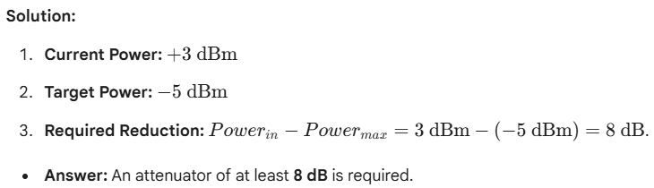
dBm ইউনিটে প্লাস (+) বা মাইনাস (-) চিহ্ন দিয়ে বোঝানো হয় যে সিগন্যালের শক্তি ১ মিলিওয়াট (1 mW) থেকে বেশি নাকি কম । যেহেতু 0 dBm = 1 mW, তাই এর ওপর ভিত্তি করে হিসাবটি করা হয়
Exercise 1: The Attenuator Problem
An optical transmitter sends a signal at +3 dBm. The receiver has a maximum input power limit (saturation point) of -5 dBm. What is the minimum value of an Optical Attenuator needed to protect the receiver if the fiber loss is negligible?

Slide 8
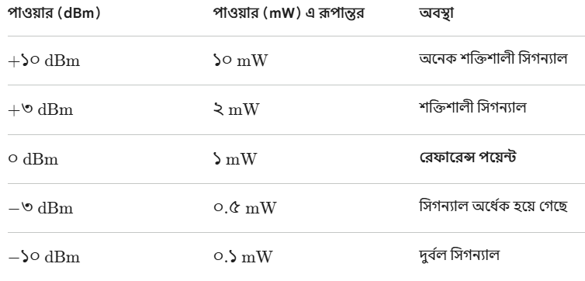


Slide 9
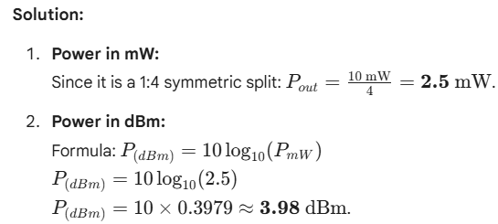
Exercise 2: Coupler Power Calculation
A laser sends a signal with 10 mW of power into a 1:4 symmetric coupler (a coupler that splits the signal equally into 4 output fibers).
Calculate the power in mW at each output port (assume no internal excess loss).
Express the output power of one port in dBm.

